Slide 1




ALAGAPPA CHETTIAR GOVERNMENT COLLEGE OF ENGINEERING AND TECHNOLOGY
KARAIKUDI
Department of Electronics and Communication Engineering
19ECZ71-Mini Project
GESTURE VOX: ENHANCING COMMUNICATION FOR INDIVIDUALS WITH SPEECH DISABILITIES
Under the Guidance of:
Dr. G. KARPAGARAJESH M.E, Ph.D.,
Associate Professor,
Department of ECE
91762214201
Present by
ABHIMANYU P

Slide 2


OBJECTIVE OF WORK
1. Enable speech-impaired individuals to communicate through gestures.
2. Convert hand gestures into audible voice in real-time.
3. Design an affordable and user-friendly solution.
4. Support up to 32 gesture combinations for flexibility.
5. Leverage embedded technology for practical impact.
“Together, we can build a world where everyone rolls through life, not just some”

Slide 3
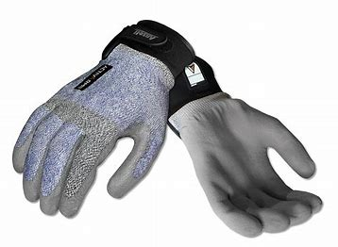
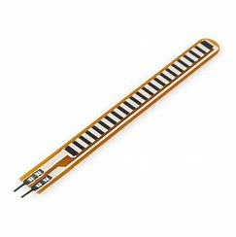
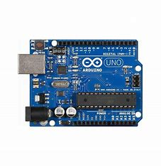
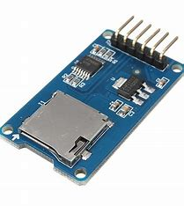
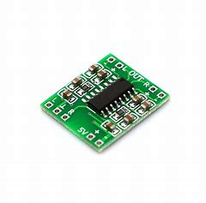
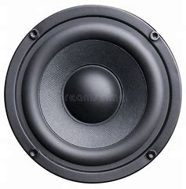
KEY COMPONENTS USED
1. GLOVE: Serves as the base for mounting the sensors.
2. FLEX SENSORS: Detect finger movements and generate gesture-specific signals.
3. ARDUINO UNO: Processes sensor inputs and controls the system.
4.SD CARD MODULE & SD CARD: Stores pre-recorded voice files for gesture outputs.
5. AMPLIFIER: Enhances the audio signal for clear playback.
6. LOUDSPEAKER: Outputs the amplified audio for communication.
7. WIRES AND CONNECTORS: Facilitate connections between components.

Slide 4
BASIC STEPS
1. Glove Setup: Attach flex sensors to the glove to detect finger movements.
2. Signal Processing: Use an Arduino Uno to read binary signals generated by the flex sensors.
3. Audio File: Mapping: Map each binary combination to pre-recorded audio files stored on the SD card.
4. Amplification: Use an amplifier to enhance the audio signal.
5. Output Voice: Play the corresponding voice output through a loudspeaker for communication.

Slide 5

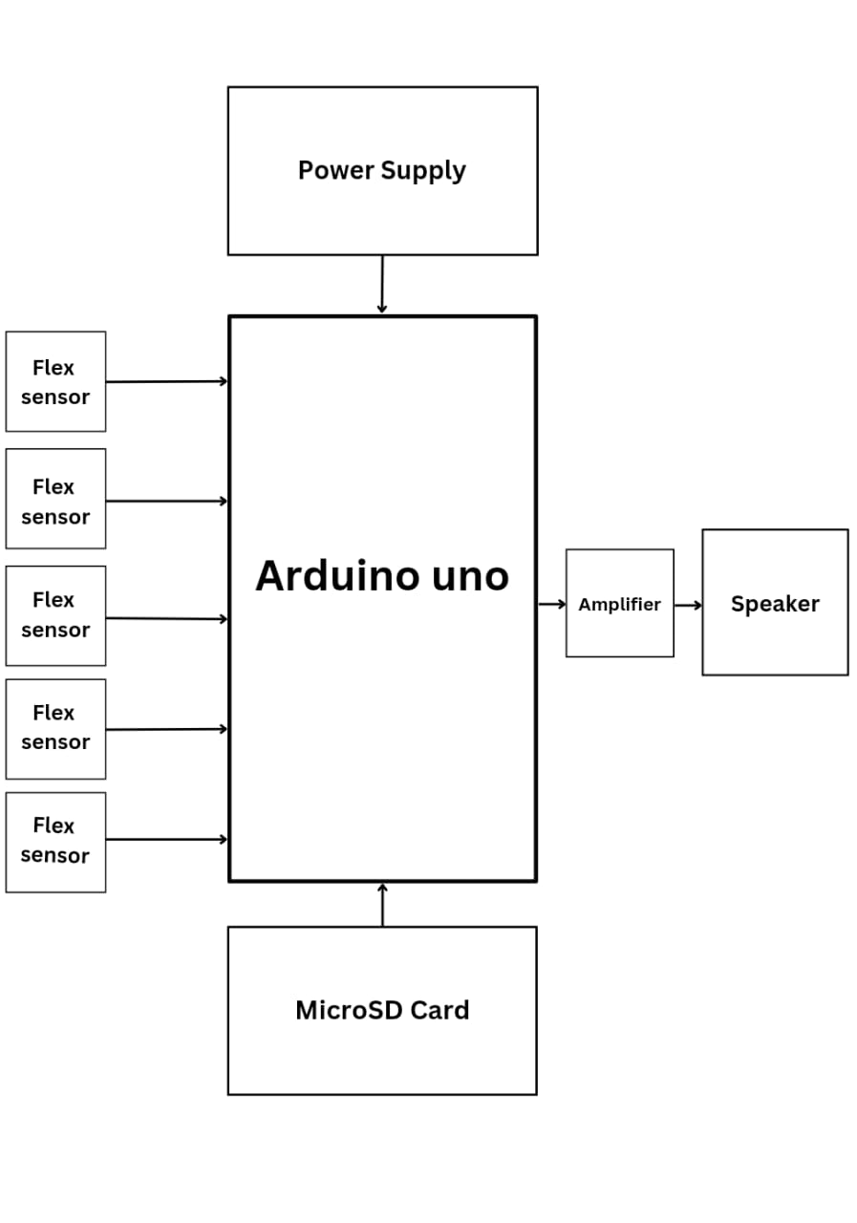
BLOCK DIAGRAM
Power Supply: Provides necessary voltage and current to power the system components.
Flex Sensors: Attached to a glove, these sensors detect finger bending, converting it to resistance changes, which are read as input signals.
Arduino Uno: Acts as the CPU, interpreting input from flex sensors, mapping them to audio files, and controlling functionality.
MicroSD Card Module: Stores pre-recorded audio files for various gestures, which the Arduino retrieves based on detected gestures.
Amplifier: Boosts the audio signal for clear output.
Speaker: Outputs amplified audio, translating gestures into voice for enhanced communication for speech-impaired users.

Slide 6

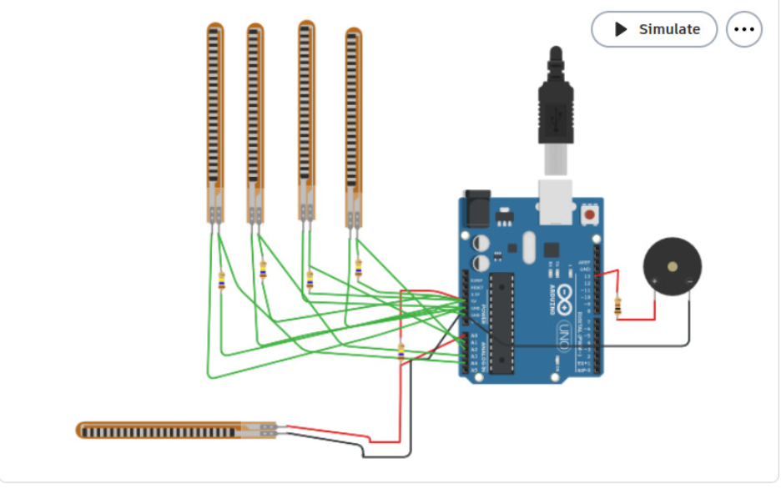
SIMULATION & CIRCUIT DIAGRAM
The circuit begins with the flex sensors, which are attached to the glove and connected to the analog pins of the Arduino Uno. These sensors detect finger movements and convert them into analog signals. The Arduino processes these signals and maps them to corresponding pre-recorded audio files stored on the MicroSD card module, which is interfaced with the Arduino.
The selected audio file is then sent to an amplifier to boost the signal strength, ensuring it is loud enough for clear communication. The amplified signal is fed to a speaker, which produces the audible output. The entire system is powered by a stable power supply, ensuring smooth and reliable operation. Proper grounding and secure connections between components are maintained to avoid interference or malfunction.

Slide 7
WORKING OF GESTURE VOX
Step 1: Data Collection from Flex Sensors Each finger's flex sensor measures resistance as the finger bends, sending analog signals to the Arduino Uno. The Arduino reads these values, comparing them to preset thresholds to determine which fingers are bent.
Step 2: Binary Code Generation The Arduino translates each sensor’s output into a binary digit: 0 for bent, 1 for straight. This creates a unique 5-bit binary code representing each gesture.
Step 3: Audio File Retrieval The generated binary code maps to a specific audio file on the microSD card. The Arduino retrieves the .wav file corresponding to the gesture via the SD card module.
Step 4: Audio Playback The audio file is played through a loudspeaker connected to a playback module (e.g., DF-Player Mini). The system emits clear audio, translating gestures into voice.
Step 5: Continuous Recognition The system continuously monitors flex sensor readings, updating binary codes in real-time as gestures change, ensuring responsive and dynamic audio output for seamless non-verbal communication.

Slide 8
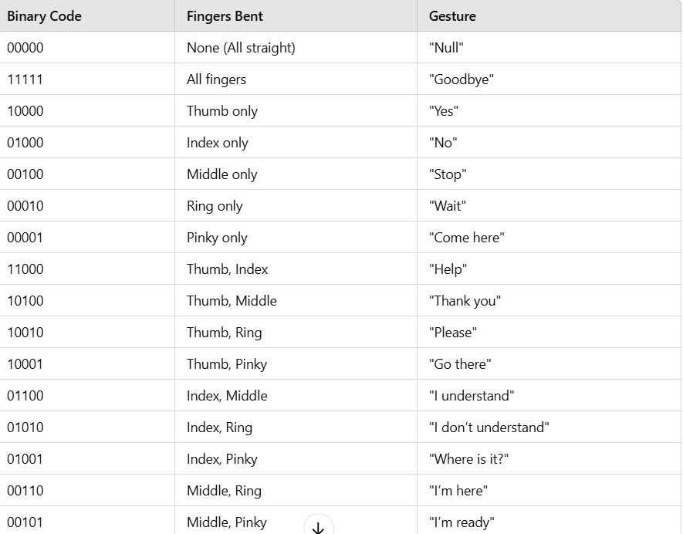
VOICE COMBINATIONS

Slide 9
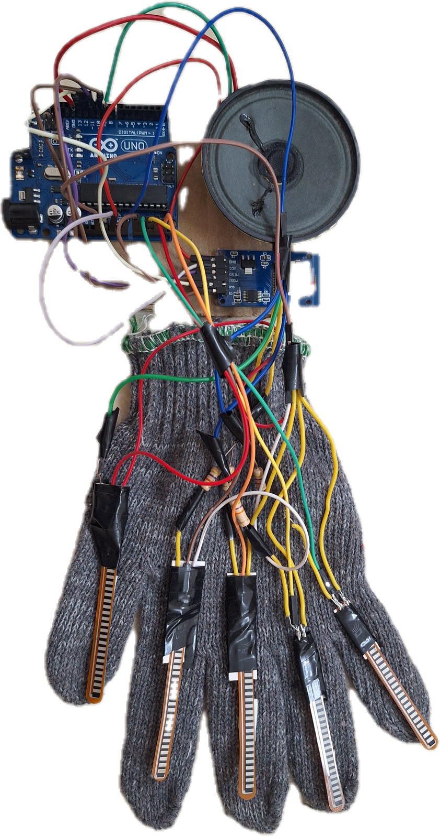
RESULT
The Gesture Vox is a glove-based device equipped with flex sensors on each finger to detect hand movements and convert them into speech. As fingers bend, sensors send analog signals to an Arduino Uno, which identifies specific gestures. These gestures map to audio files stored on a microSD card, which are then played through a loudspeaker, enabling silent gestures to produce audible communication.
This prototype demonstrates a practical assistive technology for non-verbal users. Future improvements could enhance comfort through miniaturization, streamline wiring, and integrate components within the glove. Advanced gesture recognition and wireless features may also be explored, expanding the device's adaptability and usability in daily interactions.

Slide 10
FURTURE SCOPE
The future scope for the Gesture Vox holds exciting advancements aimed at making the system more practical and accessible. Initial goals include:
Miniaturization: Reducing the size of the components to create a more lightweight, comfortable, and unobtrusive glove for daily wear.
Enhanced Gesture Recognition: Expanding the system's ability to recognize a broader range of gestures, allowing for more complex phrases and communication needs.
Vocabulary Expansion: Incorporating a more extensive vocabulary to support diverse communication scenarios.
Wireless Connectivity: Adding Bluetooth or Wi-Fi capabilities for seamless integration with mobile apps or devices, allowing for remote updates and potentially enabling customization of responses.
Battery Optimization: Improving power efficiency to support longer usage times between charges.

Slide 11

CONCULSION
The Gesture Vox is an assistive device that translates hand gestures into audible speech, empowering non-verbal individuals with speech impairments to communicate essential phrases. Using flex sensors, a microcontroller, and audio playback, the device offers a straightforward yet impactful communication tool. It highlights the potential of affordable, adaptable technology for assistive applications. Future enhancements could expand its vocabulary, improve gesture recognition, and increase user comfort, evolving it into a more powerful, customizable solution to support diverse communication needs.

Slide 12
THANK YOU

